Slide 1
OPS Git/Github Overview
June 2016

Slide 2
Concepts and Terminology
Forget what you know about centralized version control (CVCS), such as PVCS, SourceSafe, Subversion, VSTS/TFS … !
Git is a Distributed Version Control System (DVCS)
Multiple people can work on the same file at the same time; there is no locking, only merging, which is the power of DVCS
Try not to equate feature terminology
Checkout ≠ Checkout
No such thing as Checkin
A hierarchical overview: Account -> Repository -> Branch
Account: a conceptual container secured by a Github account (user/org), which owns repositories and related permissions, teams, account info, etc.
Repository (aka: repo): a conceptual container for a collection of branches; typically 3 types of repos with respect to a contributor workflow
The single main/production source for the project’s content/code, usually owned by someone else, like an organization (aka: upstream)
A contributor’s copy of the project owner’s repo, created via the forking process (aka: origin). Note that the term “fork” is used in 2 different ways:
verb: the act of creating a copy of the [upstream] repo; “a contributor can fork the project owner’s repo in order to create their own private copy [origin]”
noun: the name given to a copy of the project owner’s [upstream] repo; “the upstream repo has several forks”, “my origin repo is a fork”
A local copy of your origin repo, created via the cloning process, residing on a local device to facilitate the content creation/update workflow (aka: local)
Branch: Just think of it as a logical name for set of directories/files, and the place where a contributor works
Technically, it’s used to track a versioned set of files and all of their changes (aka: commit history) over time
“master” is the default main branch in a repo; it’s common to partition content/source versions using separate branches (ie: for releases, major events, etc.)
“live” is the publishing branch in OPS
You make edits to source files in a branch (which is contained in a repo)
You bundle up edits into a discrete unit of change called a commit, which are applied to the branch you are working on
Commits in one branch, can be applied to another branch, through the merge process

Slide 3
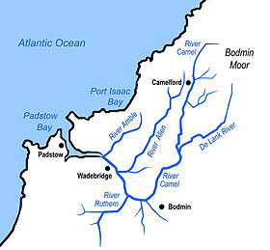
The GitHub + OPS watershed
Live content
Your branch
Your fork
Master branch

Slide 4
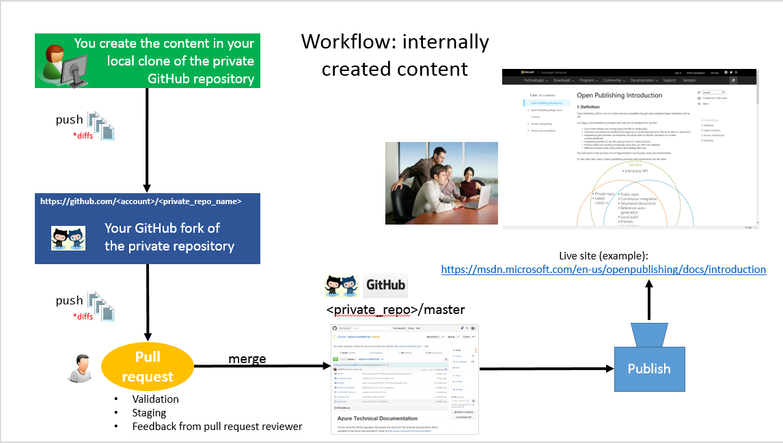
OPS workflow

Slide 5

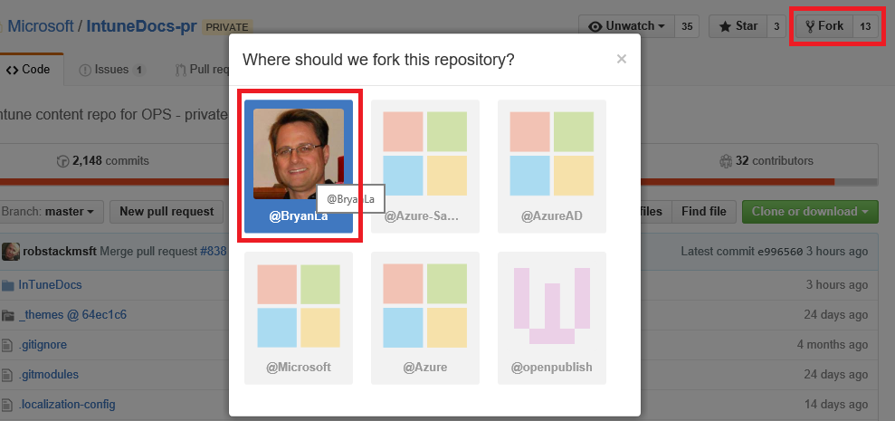




https://github.com
1. Fork
Organization
User
/microsoft [account]
/me [account]
/IntuneDocs-pr.git [repo]
/IntuneDocs-pr.git [repo]
:master [branch]
/InTuneDocs
readme.md
:master [branch]
/InTuneDocs
README.MD
7. Merge PR
6. Open PR for validation/staging
:release-june16
/InTuneDocs
README.MD
:mybranch [branch]
/InTuneDocs
readme.md
2. Clone [origin]
3. Pull [upstream]
5. Push [origin]
Local File System
C:\users\me\git
\IntuneDocs-pr [repo]
\.git
4. Checkout work branch
a. edit, add, commit b. validate with local build, test
:master [branch]
:mybranch [branch]
\InTuneDocs (mybranch)
readme.md
One time
\InTuneDocs (master)
readme.md
Recurring
Notes:
Blue Box ~= Account
Green arrows = initialization
Blue arrows = ongoing contribution cycle
PR
One per branch, per Github user
Can be kept open for as long as necessary for validation/staging of commits
Tested for “mergeability” of commits
Merge conflict = can’t be merged
Once merged, they are closed
CLONE
If you don’t use a credential cache (see resources), it will prompt for OAuth credentials (Github User ID, and Personal Access Token). Alternative is to let clone prompt you each time you clone a new repo, then reconfigure the “origin” remote using embedded form of credentials, ie: git clone https://BryanLa:<token>@github.com/<your GitHub user name>/IntuneDocs-pr.git

Slide 6
More Terminology
Clone: ‘git clone <repo-URL>’, a meta command that creates a directory in your local file system, initializes a repo structure (/.git) in the directory, sets up the ‘origin’ remote, copies the remote repository (ie: ‘origin’) into it, and does a checkout on the ‘master’ branch into your working directory
Working Directory [physical]: the area in your local file system monitored by Git Bash, created by ‘git clone’, where you to make changes to the working branch
Working Branch [logical]: the branch “checked out” into your working directory (via ‘git checkout’); ‘git clone’ does this on the ‘master’ branch
Remote: a named connection (alias) between the ‘local’ repo and an ‘origin’/’upstream’ repo, which allows you to transfer data to/from each
Pull: ‘git pull <remote> <branch>’, is a Fetch + Merge meta command, that retrieves changes from the branch of a remote repo, and applies (merges) them into the current working branch. For example, ‘git pull upstream master’ will do the following:
Fetch: runs ‘git fetch upstream master’ to copy all changes from ‘upstream:master’, into your local repo (.git subdirectory, NOT the working directory)
Merge: runs ‘git merge’ to merge the set of commits that resulted from the Fetch into your current working branch
Note: if the commits cannot be merged automatically by Git, it will result in a merge conflict
Merge Conflict: the inability of Git to merge a set of commits into a branch; you are notified of the conflict, and Git will write conflict markers in the file(s) to indicate where the merge failed
Checkout: the way you copy a branch out of your local repo, into your working directory; aka working branch. Conversely, you must first have a clean working branch, on which all changes have been committed back into your local repo, before you do a checkout
Pull Request (PR): a way of bundling the commits on branch, and requesting they be pulled from one branch (typically in “origin”) and merged into the target branch (typically in “upstream”). A Pull Request essentially breaks the Pull process into 2 steps, by queueing the operation and delaying the Merge
Push: ‘git push <remote> <branch>’, like the opposite of pull, it pushes the updates from your working branch, into the remote branch. If a Pull Request is open on the remote branch, it will update the pull request as well. In our case, that means triggering validation and staging each time you do a Push.
Note: this implies you have write perms, and normally you push to your “origin” repo. You can’t push to a remote branch on which you don’t have write perms.

Slide 7
Resources
Git/Github ramp up
Learn Git Code Academy course (approx. 2 hours)
Pluralsight Try Git free course
Github.com Good Resources for Learning Git and GitHub
GitGuys.com
Pro Git e-book
Setup/config resources
Github.com/Microsoft Open Source Hub for governance (associating MSFT/Github accounts, repos, perms, etc.)
OPS documentation
From ACOM
ACOM Contributor’s Guide: Authoring articles: tools, processes, guidance, first 2 bullets
Aquent training: Cheat Sheets
ACOM Guidance Wiki
Various getting started and cheat sheet articles compiled by ACOM engineering
Cache your Git account credentials locally: Git Credential Manager for Windows
Supports MFA for Github and VSTS; Replaces http://gitcredentialstore.codeplex.com/
Visual Studio Integration
Channel 9: Using Git in Visual Studio
MSDN: Use Visual Studio and Team Foundation Server with Git
Using Git with Visual Studio and TFS
Writing
ATOM Markdown editor
VS Code Markdown Editor

Slide 8
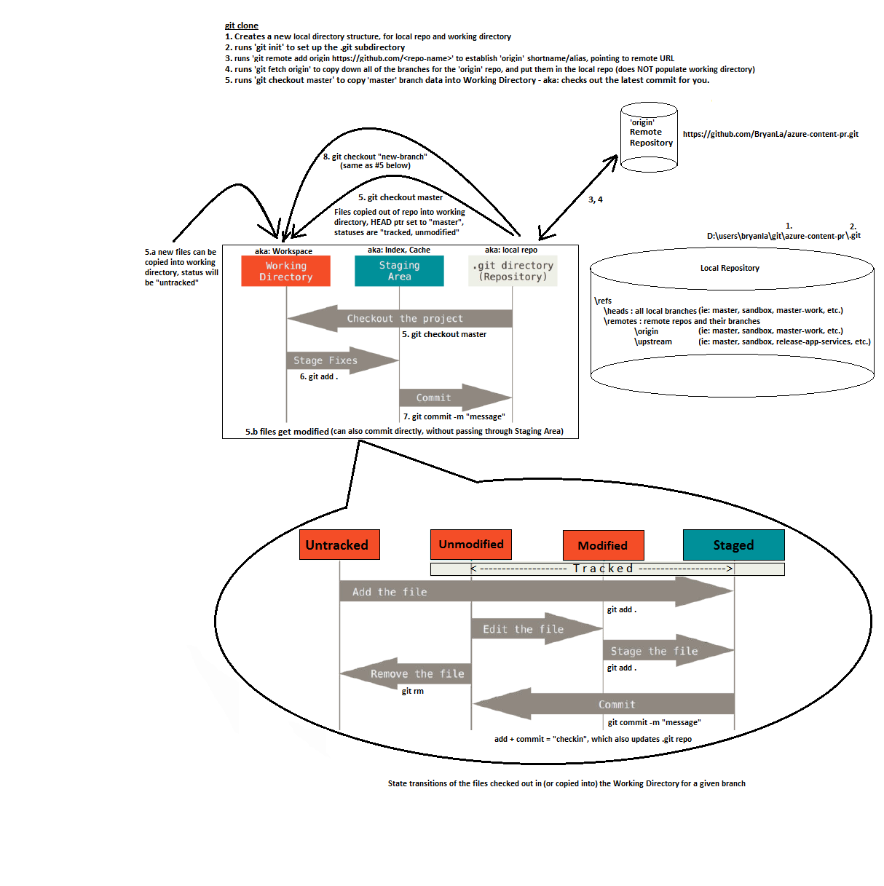
Local repo workflow

